Slide 1
Potential aggregations of Environmental variables

Slide 2
Discussed potential Environmental variables
DWD (station observation)
air temperature and dew temperature,
wind speed, wind direction
ERA 5 Land (historical)
Air temperatures
Dewpoint temperature
Wind direction and wind speed
WRF Chem
Air quality
PM 2.5, O₃, NO₂
Noise Map (Robin could provide noise data)
Traffic, Rail, Aviation (Day and night)
LfU stations (PM 2.5, O₃, NO₂)

Slide 3
1. DWD Station observations
For temperature data
Some health conditions might associate with a seasonal as well as acute variation in weather conditions than with absolute temperature.
Bauer et al. 2022; https://doi.org/10.1038/s41598-022-09644-5
T_{max}
T_{min}
T_{mean}
Temperature change between two days (Δ_{d2}T)
Temperature change within three days (Δ_{d3}T)
Daily temperature amplitude (T_{range} = T_{max} – T_{min})
Maximal temperature amplitude between two days T_{range_max} (T_{max} − T_{min} of two consecutive days: T_{range_max_a} = T_{max_yesterday} − T_{min_today}, T_{range_max_b} = T_{max_today} − T_{min_yesterday})
Ghada et al. 2021; https://doi.org/10.1016/j.scitotenv.2020.143772
Lag effects:
T_{d-1}
T_{d-2}
T_{d-3}
Or until 7 days for more explorations

Slide 4
1. DWD Station observations
For temperature data
Fritze 2020, https://doi.org/10.3390/su12093664
Heat and Cold Waves:
Heat index for > 20°C
Wind Chill Temperature index for < 10°C
Fritze 2020 mentioned following calculation methods referring to the mentioned sources
Heat Index
HI = -42.379 + 2.04901523T + 10.14333127R - 0.22475541TR - 6.83783x10⁻³T² - 5.481717x10⁻²R² + 1.22874x10⁻³T²R + 8.5282x10⁻⁴TR² - 1.99x10⁻⁶T²R²
where T = ambient dry bulb temperature (°F)
R = relative humidity (integer percentage)
Source: Rothfusz, L.P. The Heat Index Equation; SR 90-23; National Oceanic and Atmospheric Administration, National Weather Service, Office of Meteorology: Fort Worth, TX, USA, 1990.
https://wonder.cdc.gov/wonder/help/Climate/ta_htindx.PDF
Wind Chill Temperature Index
WCTI = 13.12 + 0.6215T – 11.37V^{0.16} + 0.3965TV^{0.16}
where T = air temperature in °C
V = wind speed in km h ⁻¹ at 10 m elevation
Source: OFCM. Report on Wind Chill Temperature and Extreme Heat Indices: Evaluation and Improvement Projects; Office of the Federal Coordinator for Meteorological Services and Supporting Research: Washington, DC, USA, 2003. http://weather.missouri.edu/gcc/OFCMWindchillReport.pdf

Slide 5
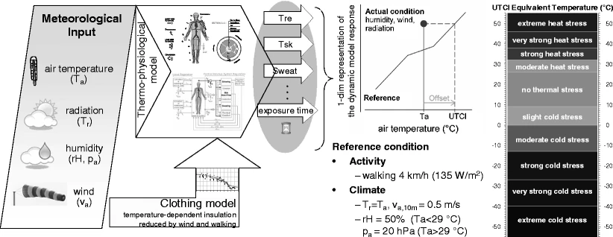
1. DWD Station observations
Universal Thermal Climate index (UTCI) for the assessment of the thermophysiological effects of the atmospheric environment.
Napoli et al. 2018 (https://doi.org/10.1007/s00484-018-1518-2):
“For a given combination of air temperature, wind, radiation and humidity, the UTCI is defined as the air temperature of a reference environment that would elicit in the human body the same UTCI-Fiala model’s response (sweat production, shivering, skin wettedness, skin blood flow and rectal, mean skin and face temperatures) as the actual environment.”
Bröde et al. 2012 (https://link.springer.com/article/10.1007/s00484-011-0454-1)
As operationalised here, the UTCI is defined as the air temperature (Ta) of the reference condition causing the same model response as the actual condition.
UTCI (Ta, Tr, va, pa) =Ta +Offset (Ta, Tr, va, pa)
The offset, i.e. the deviation of UTCI from air temperature depends on the actual values of air and mean radiant temperature (Tr), wind speed (va) and humidity, expressed as water vapour pressure (pa) or relative humidity (rH).
Ghada et al. 2021 mentioned that they used DWD sources to calculate UTCI. As the direct and diffuse radiation were not available, relative humidity and the cloud cover were used to estimate mean radiant temperature
Source: Bröde et al. 2021 Fig 1.

Slide 6
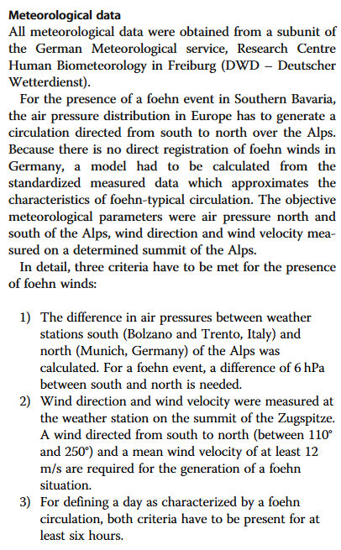

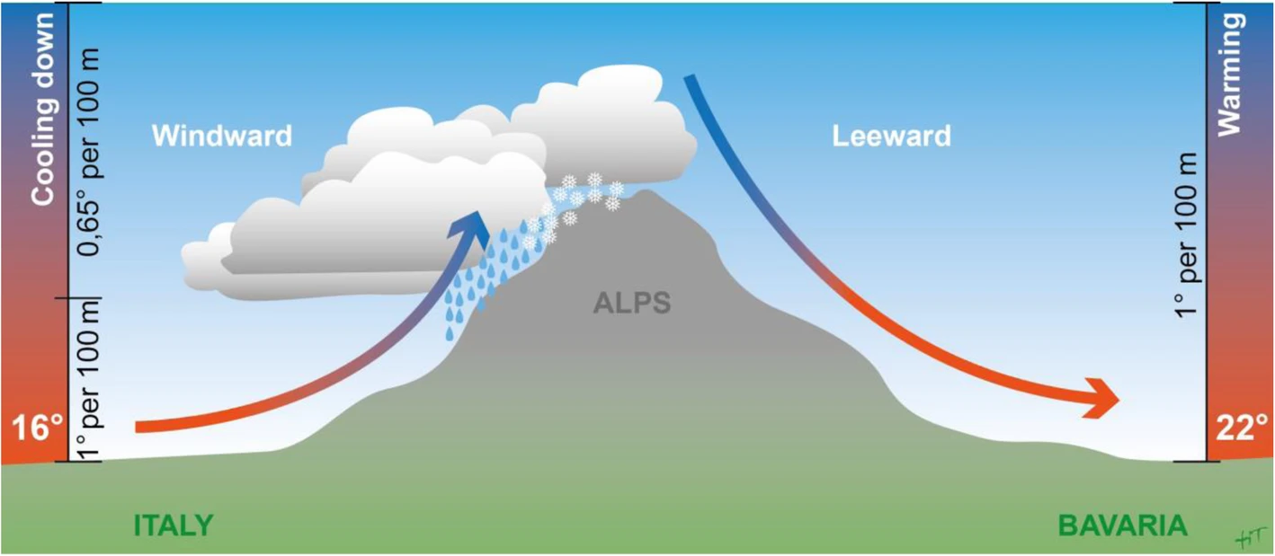
1. DWD Station observations
For wind data: Foehn winds
https://doi.org/10.1186/s12891-020-03572-z

Slide 7
2. ERA5 Land dataset
24-hour mean
24-hour maximum
24-hour minimum
Certain days average
Monthly, Seasonal and Annual averages
Apparent temperature (AT)
AT=−2.653+(0.994*T)+(0.0153*DT²) https://doi.org/10.1161/CIRCULATIONAHA.108.815860
But there are several other equations in different literatures.
Physiological Equivalent Temperature (PET) using models such as RayMan (with software) or SkyHelios (Matzarakis et al. 2021).
Sharafkhani et al. 2018 (https://doi.org/10.1016/j.jtherbio.2017.11.012) mentions: “The required variables to calculate the PET index include: A) geographical variables such as altitude and latitude of the area under study, B) meteorological variables such as dry air temperature (°C), relative humidity (%), wind speed(m/s)and cloudiness(octas); and C) individual variables such as height, weight, age, gender, clothing and physical activity (W/m²).”
Temperature humidity index (THI): using air temperature and dew point temperature (Rosenberg et al. 1983)

Slide 8
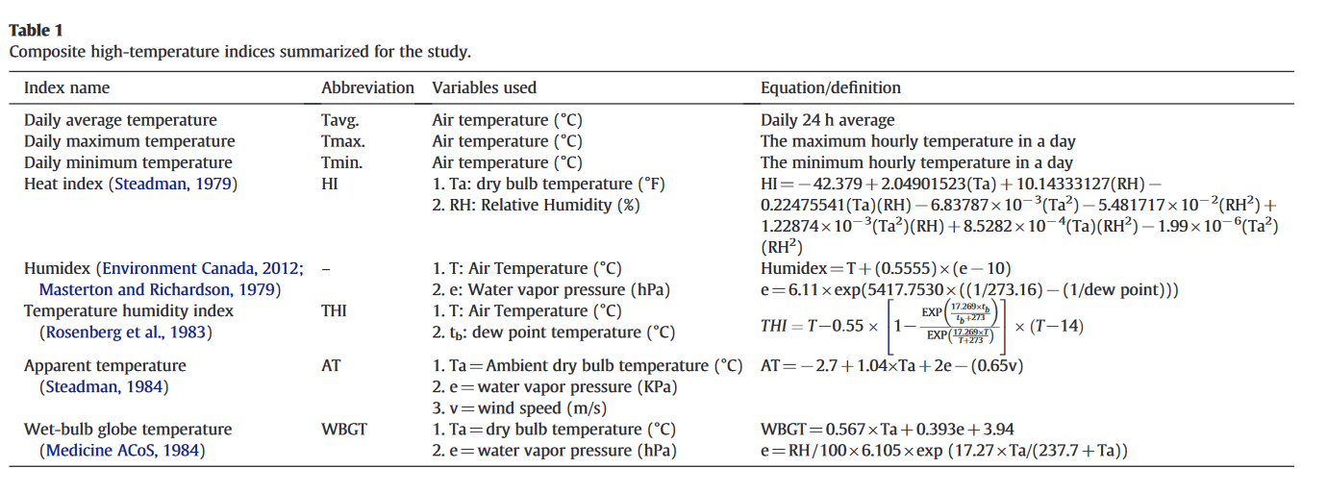
2. ERA5 Land dataset
More temperature indices
Source: Lin et al. 2012 https://doi.org/10.1016/j.scitotenv.2012.04.039

Slide 9
2. ERA5 Land dataset
Wind speed measured at 10 m can be converted to Wind speed at 2 m using the logarithmic wind profile for roughness-length 1m referring “Stull, R. Atmospheric boundary layer. In Meteorology for Scientists and Engineers; Brooks Cole: Vancouver, BC, Canada, 2011; pp. 687–722.”

Slide 10
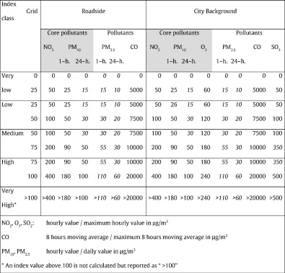
Air pollution data
Common Air Quality Index
An index with a set of two indices: roadside monitoring sites and average city background conditions
Concept and calculation details described in
Elshout et al. 2014 https://doi.org/10.1016/j.scitotenv.2013.10.060
Elshout et al. 2008 https://doi.org/10.1016/j.envint.2007.12.011

